Slide 1
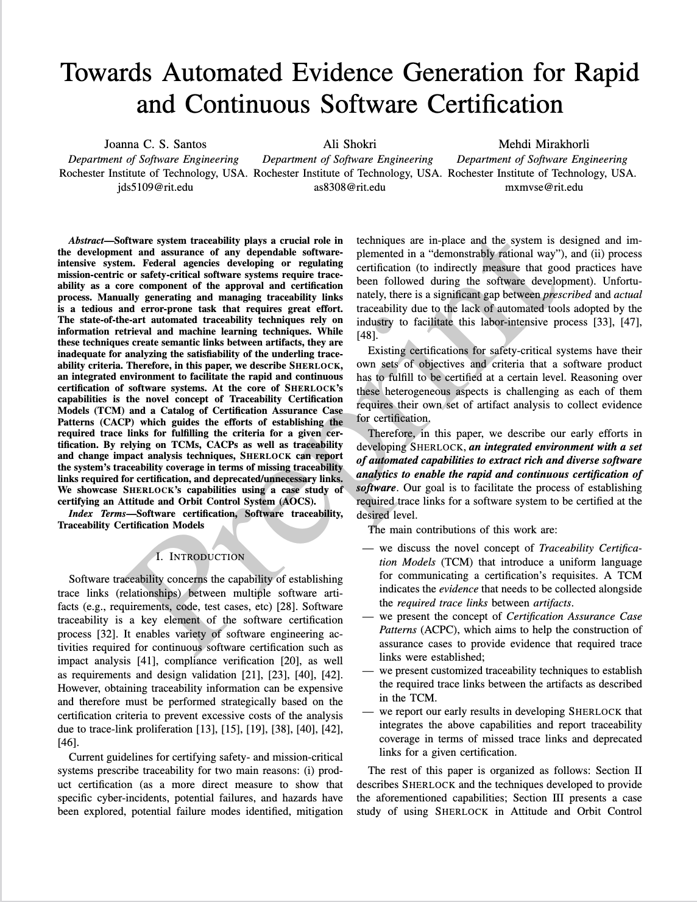

Slide 2
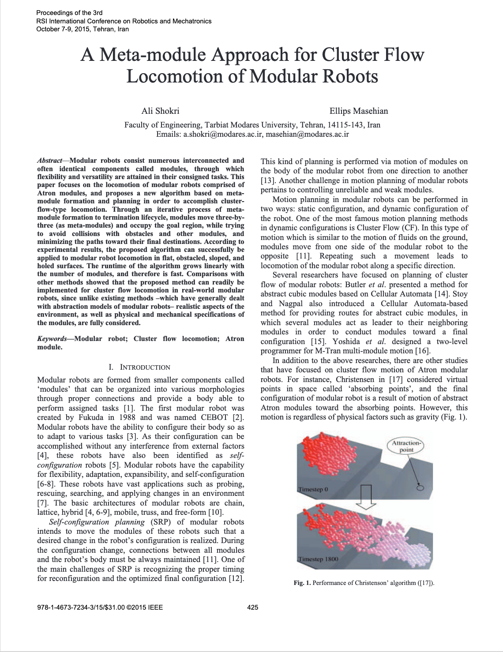

Slide 3
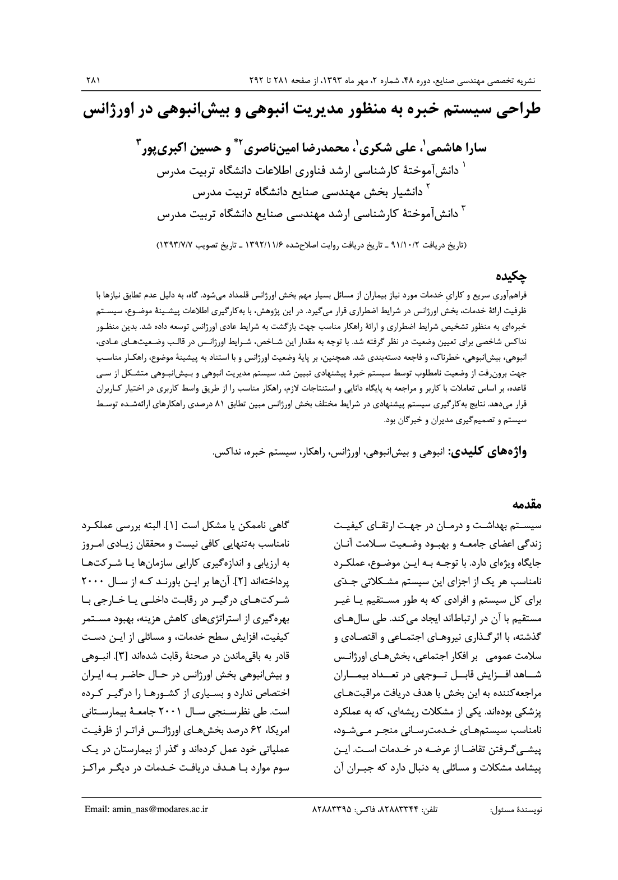

Slide 4
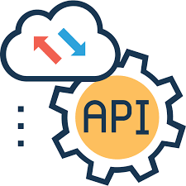

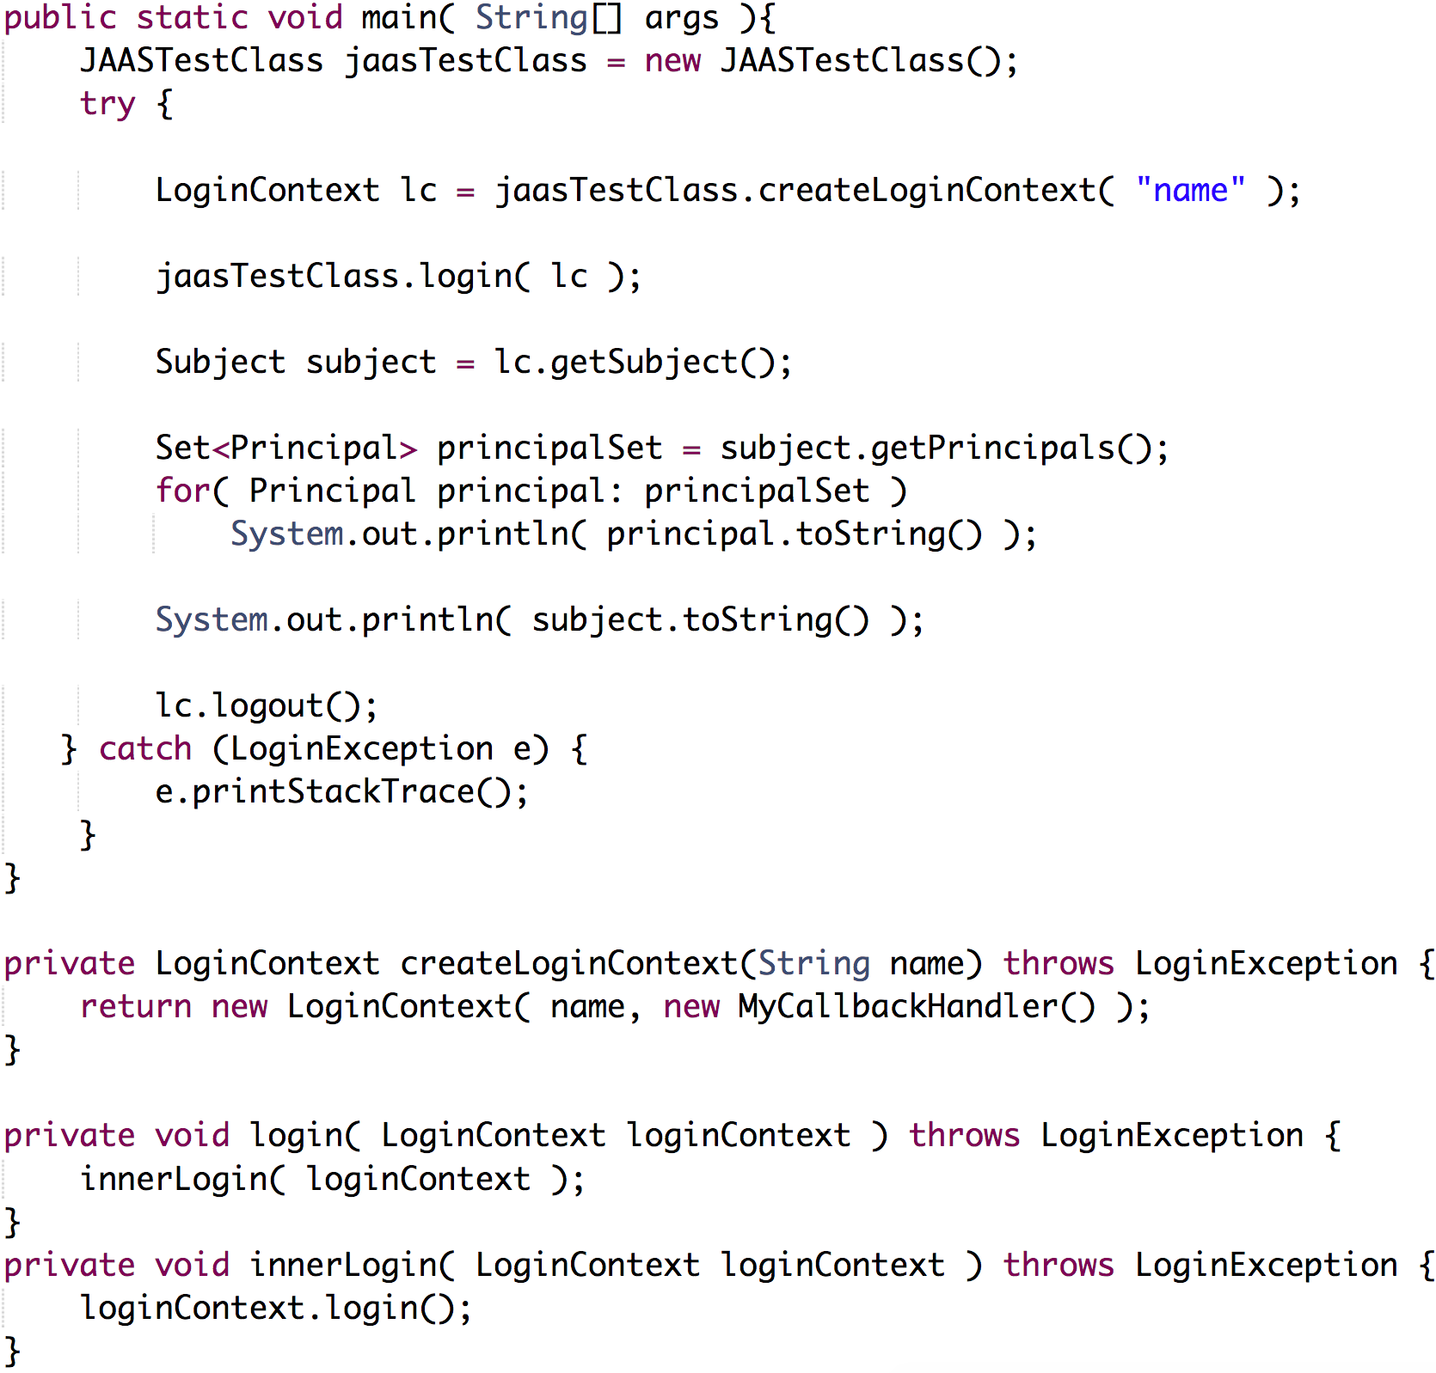



Incomplete Program Specification
Framework API
Program Analysis & API Usage Extraction
API Usage Patterns
Component-based Program Synthesis
Synthesized Program
Code Repositories

Slide 5




Slide 6
2004
2005
2006
2007
2008
2009
2010
2011
2012
2013
2014
2015
2016
2004
2005
2006
2007
2008
2009
2010
2011
2012
2013
2014
2015
2016
2017
2018
2019
2020
2021

Slide 7
2004
2005
2006
2007
2008
2009
2010
2011
2012
2013
2014
2015
2016
2004
2005
2006
2007
2008
2009
2010
2011
2012
2013
2014
2015
2016
2017
2018
2019
2020
2021
Paliz
Frlcr
7 mos
Melat Insurance
RIT
Activities:
RNF
Software Development
10 mos
4 yrs 1 mo
4 yrs 9 mos
Since Jan 2018
Software Design
2004
2005
2006
2007
2008
2009
2010
2011
2012
2013
2014
2015
2016
2017
2018
2019
2020
2021
Software Architecture
Team Leading
Raydana
SEA
Research
6 yrs 1 mo
1 yr 4 mos
Rose
3 m

Slide 8
2021
2020
2019
2018
2017
2016
2015
2014
2013
2012
2011
2010
2009
2008
2007
2006
2005
2004

Slide 9
2021
2020
2019
2018
2017
2016
2015
2014
2013
2012
2011
2010
2009
2008
2007
2006
2005
2004

